Slide 1
Insurance Premium Prediction
Prepared by : Pratham A. Kyada
External Guide: Mr. Sahaj Godhani

Slide 2
Introduction
The traditional approach to determining insurance costs involves complex manual assessments, lengthy application processes, and significant waiting periods before customers receive accurate premium quotes.
Machine Learning (ML) provides a fast, efficient, and accurate approach to predict insurance premiums using individual health and demographic data.

Slide 3
Problem Statement
The goal of this project to give people an estimate of how much they need based on their individual health situation. After that, customers can work with any health insurance carrier and its plans and perks while we keeping the projected cost from our study in mind. This can assist a person in concentrating on the health side of an insurance policy rather than the ineffective part.

Slide 4
Tools and Technologies
Python Modules – Pandas, Numpy, Matplotlib, seaborn, Sklearn
ML Algorithm – Linear Regression, Decision Tree Regressor, Random Forest Regressor, Gradient Boosting Regressor, XGBoost Regressor, KNN
Tools – Google Colab, VS Code
Deployment – Streamlit

Slide 5
Architecture
Install Necessary Libraries
Import Libraries
Load and Preprocess Dataset
Model Building
Train and Test Split
Filter and Handling Dataset
Evaluate Model
Deployment

Slide 6
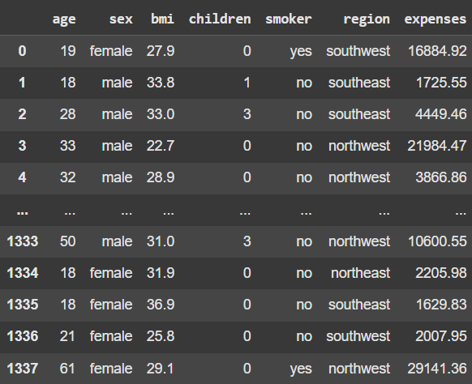
Load Dataset

Slide 7
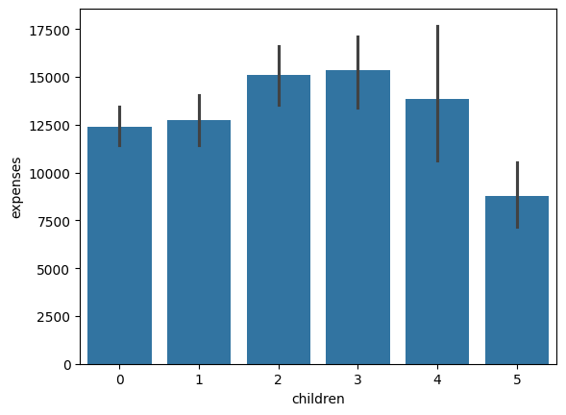
Number of Children and Its Expenses

Slide 8
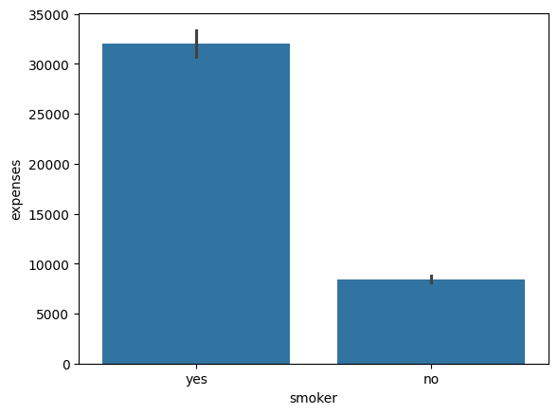
The relationship between 'smoker' and 'expenses'

Slide 9
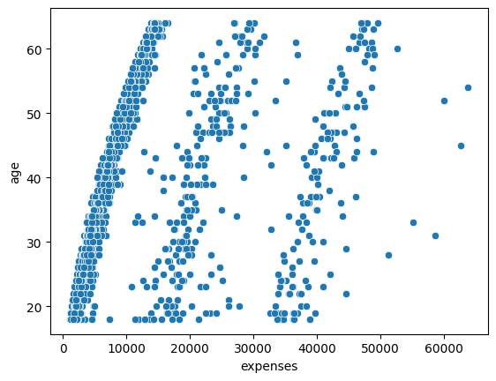
Age Wise Expanses

Slide 10
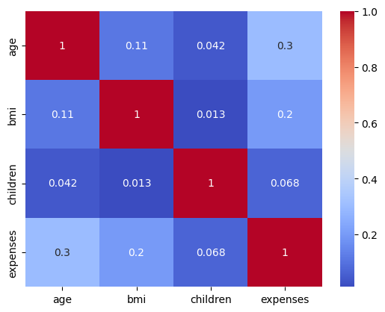
Correlation Matrix

Slide 11
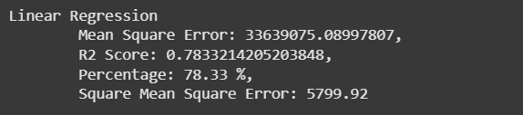
Linear Regression

Slide 12
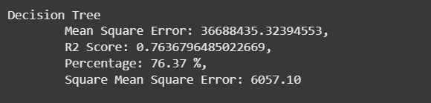
Decision Tree

Slide 13
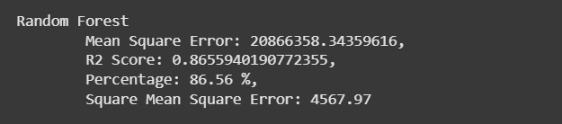
Random Forest

Slide 14
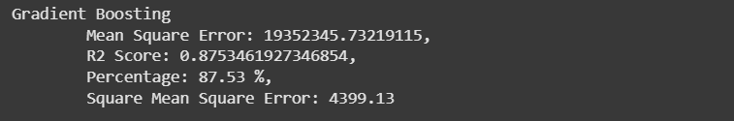
Gradient Boosting

Slide 15
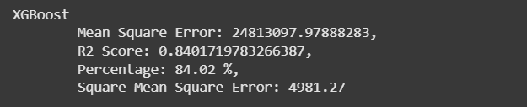
XGBoost

Slide 16
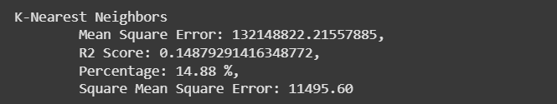
K-Nearest Neighbors

Slide 17
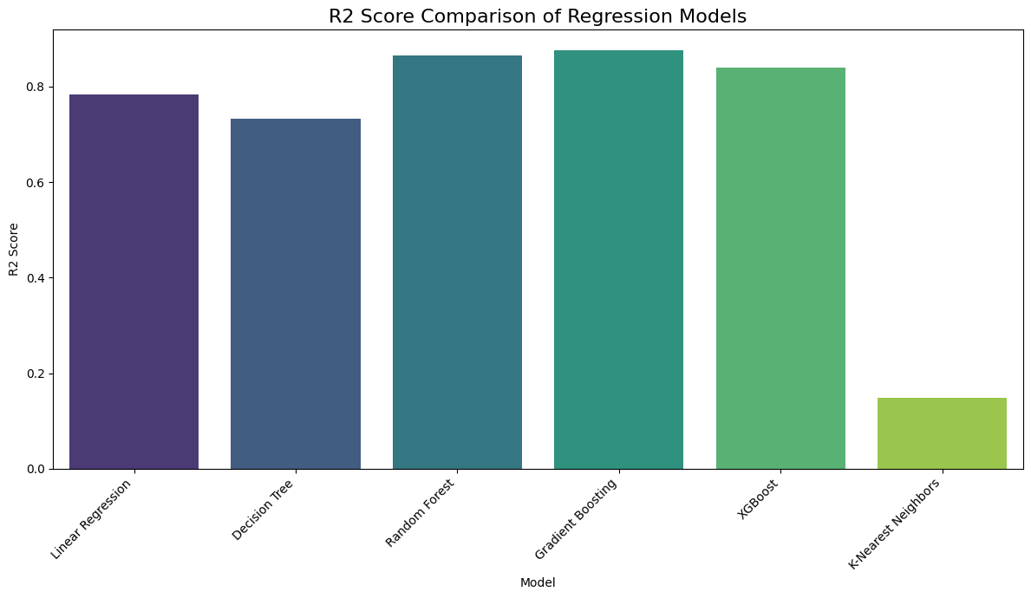
Comparison of Model Accuracies​

Slide 18
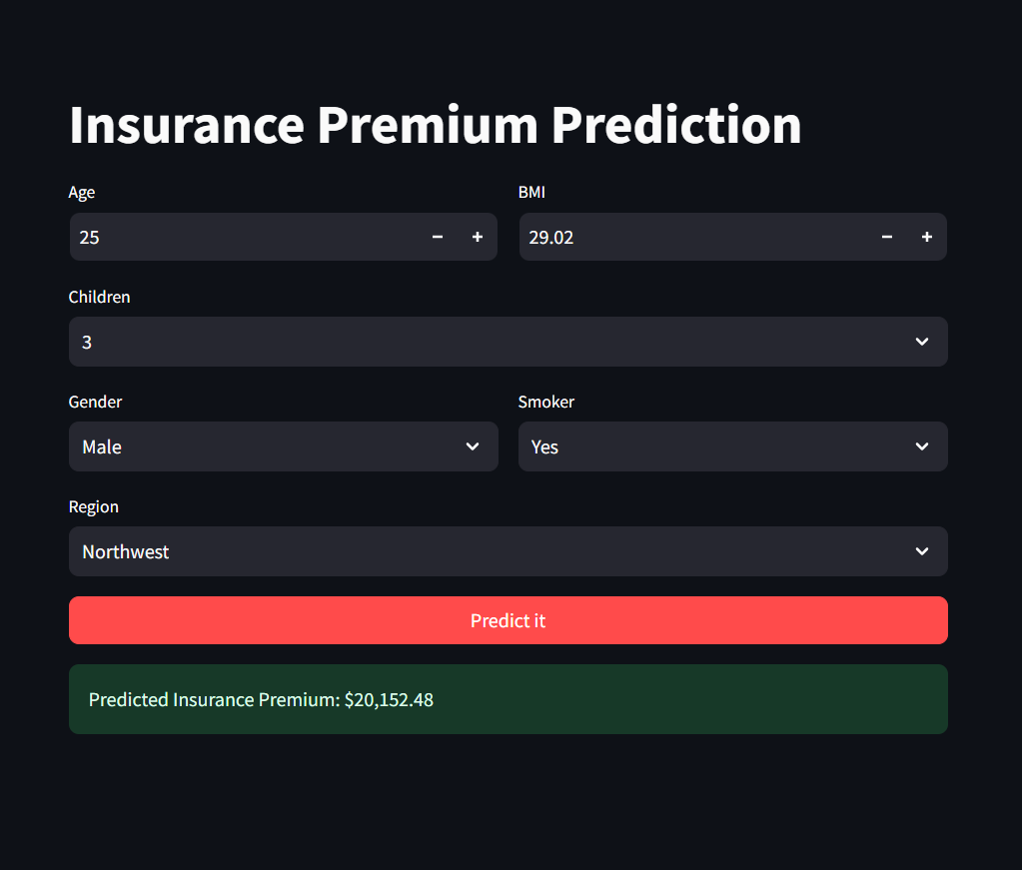
Deployment

Slide 19
THANK YOU

